Slide 1
Do More with Less
Notes:
Key slide takeaway: Today we’re going to talk about how Microsoft Security can help your organization do more with less with Microsoft Security.

Slide 2

CISOs are under pressure to contain costs
Conventional security tools have not kept pace
Cost of security breaches is rising
Resources are constrained
“Boards are now pushing back for improved understanding of what they have achieved after years of such heavy investment.” ¹
Paul Proctor Distinguished VP Analyst, Gartner
Significantly more security decision makers have felt pressure to cut costs within the past 6 months²
82%
#1
feel pressured to lower costs ³
priority to reduce cost is improved threat protection
¹ “The Urgency to Treat Cybersecurity as a Business Decision” February, 2020
² March 2022 survey of 501 US Security Decision Makers commissioned by Microsoft from agency, Vital Findings
³ Microsoft Pandemic CISO Survey” 2020
Notes:
Key slide takeaway: CISOs are under pressure to contain costs from their boards. Security costs are rising as security breaches and threats multiply, and meanwhile companies are being asked to “do more with less.”
Main points to cover:
Security breaches can lead to losses in many forms, including employee and customer downtime from revenue generating activities.
Boards want to see ROI after years of increased security investments
Improved threat protection is a key way to reduce costs
Citations:
¹ “The Urgency to Treat Cybersecurity as a Business Decision” February, 2020
² March 2022 survey of 501 US Security Decision Makers commissioned by Microsoft from agency, Vital Findings
³ Microsoft Pandemic CISO Survey” 2020

Slide 3
Microsoft Security helps you do more with less
Simplify Vendor Management
Reduce threats with AI and Automation
Improve Operational Efficiency
Notes:
Simplifying your organization’s security landscape can lead to robust cost savings including vendor license cost consolidation, reducing threats through streamlined dashboards, AI, and automation, streamlining SecOps, and reducing time spent on administration and deployment which can improve your bottom line. Microsoft Security can help you achieve savings in three ways:
Simplify Vendor Management
Reduce threats with AI and Automation
Improve Operational Efficiency
Let’s dive in to each one… (click)

Slide 4
Do More With Less with Microsoft Security
Simplify Vendor Management | Reduce threats with AI and Automation | Improve Operational Efficiency
Integrate up to 50 product categories
Eliminate redundant capabilities
Consolidate number of contracts to manage
Cut third party consulting and deployment costs
Detect and respond faster and more accurately to attacks and insider risks
Protect and govern your sensitive data
Manage and govern your on-premises, multi-cloud, and software-as-a-service (SaaS) data
Improve compliance, monitor and remediate potentially risky activity, and safely enable productive work for employees using multiple devices in multiple locations.
Increase SecOps efficiency with a unified SIEM and XDR experience
Secure access across your multifaceted digital landscape and the connected world
Protect against breaches with deeply integrated solutions that secure identities, devices apps and data
Improve visibility across identities and endpoints
60% savings by consolidating licenses with Microsoft 365 E5 Security and Microsoft 365 E5 Compliance 1
30% savings from unifying cloud security tools with Defender for Cloud 2
60% reduced risk of material breach,
65% less time to investigate threats, and
88% less time responding to threats with
Microsoft Sentinel, Microsoft 365 Defender, and
Microsoft Defender for Cloud 3
96% less time spent monitoring potential suspicious activity with Microsoft Purview ⁴
$10.5 million additional end user productivity from automation and process improvements in
Microsoft 365 Defender ⁵
90% reduction in noise, elevating the most critical issues
with Microsoft Sentinel ⁶
73% improved efficiency of network-related IT work with Azure Network Security 7
67% reduced time to deployment with Microsoft Sentinel ⁸
75% reduction in password requests after introducing
Self-service Single-Sign-On (SSO) with
Azure Active Directory 9
$479,000 in human capital freed up by redeploying IT time with Microsoft Endpoint Manager 10
Forrester Consulting showed organizations saved substantially by moving to Microsoft Security
¹ Savings based on publicly available estimated pricing for other vendor solutions and Web Direct/Base Price shown for Microsoft offerings
2. Forrester Consulting, “The Total Economic Impact ™ Of Microsoft Azure Security Center,” June, 2021, commissioned by Microsoft
3. Forrester Consulting, “The Total Economic Impact™ Of ™ Microsoft SIEM and XDR”, August 2022, commissioned by Microsoft
4. Forrester Consulting, “The Total Economic Impact ™ Of Microsoft 365 E5 Compliance,” February, 2021, commissioned by Microsoft
5. Forrester Consulting, “The Total Economic Impact™ Of Microsoft 365 Defender”, April 2022, commissioned by Microsoft
6. Microsoft blog: Azure Sentinel uncovers the real threats hidden in billions of low fidelity signals, Feb 2020
7 Forrester Consulting, “The Total Economic Impact ™ Of Microsoft Azure Network Security” May, 2021, commissioned by Microsoft
8. Forrester Consulting, “The Total Economic Impact ™ Of Microsoft Azure Sentinel,” November, 2020, commissioned by Microsoft
9. Forrester Consulting, “The Total Economic Impact™ Of Zero Trust Solutions From Microsoft”, December 2021, commissioned by Microsoft
10. Forrester Consulting, “The Total Economic Impact ™ Of Microsoft Endpoint Manager,” April 2021, commissioned by Microsoft
Notes:
Simplifying your organization’s security landscape can lead to robust cost savings including vendor license cost consolidation, reducing threats through streamlined dashboards, AI, and automation, streamlining SecOps, and reducing time spent on administration and deployment which can improve your bottom line. Microsoft Security can help you achieve savings in three ways:
Simplify Vendor Management
Integrate up to 50 product categories
Eliminate redundant capabilities
Consolidate number of contracts to manage
Cut third party consulting and deployment costs
Potential cost savings:
60% savings by consolidating licenses with Microsoft 365 E5 Security and Microsoft 365 E5 Compliance 1
30% savings from unifying cloud security tools with Defender for Cloud 2
Reduce threats with AI and Automation
Detect and respond faster and more accurately to attacks and insider risks
Protect and govern your sensitive data
Manage and govern your on-premises, multi-cloud, and software-as-a-service (SaaS) data
Improve compliance, monitor and remediate potentially risky activity, and safely enable productive work for employees using multiple devices in multiple locations.
Potential cost savings:
60% reduced risk of material breach with Microsoft Sentinel, Microsoft 365 Defender, and Microsoft Defender for Cloud ³
65% less time to investigate threats,with Microsoft Sentinel, Microsoft 365 Defender, and Microsoft Defender for Cloud ³
88% less time responding to threats with Microsoft Sentinel, Microsoft 365 Defender, and Microsoft Defender for Cloud ³
96% less time spent monitoring potential suspicious activity with Microsoft Purview ⁴
$10.5 million additional end user productivity from automation and process improvements in Microsoft 365 Defender ⁵
90% reduction in noise, elevating the most critical issues with Microsoft Sentinel ⁶
Improve Operational Efficiency
Increase SecOps efficiency with a unified SIEM and XDR experience
Secure access across your multifaceted digital landscape and the connected world
Protect against breaches with deeply integrated solutions that secure identities, devices apps and data
Improve visibility across identities and endpoints
Potential cost savings:
73% improved efficiency of network-related IT work with Azure Network Security 7
67% reduced time to deployment with Microsoft Sentinel ⁸
75% reduction in password requests after introducing Self-service Single-Sign-On (SSO) with Azure Active Directory 9
$479,000 in human capital freed up by redeploying IT time with Microsoft Endpoint Manager 10
Citations
¹ Savings based on publicly available estimated pricing for other vendor solutions and Web Direct/Base Price shown for Microsoft offerings
Forrester Consulting showed organizations saved substantially by moving to Microsoft Security
2. Forrester Consulting, “The Total Economic Impact ™ Of Microsoft Azure Security Center,” June, 2021, commissioned by Microsoft
3. Forrester Consulting, “The Total Economic Impact™ Of ™ Microsoft SIEM and XDR”, August 2022, commissioned by Microsoft
4. Forrester Consulting, “The Total Economic Impact ™ Of Microsoft 365 E5 Compliance,” February, 2021, commissioned by Microsoft
5. Forrester Consulting, “The Total Economic Impact™ Of Microsoft 365 Defender”, April 2022, commissioned by Microsoft
6. Microsoft blog: Azure Sentinel uncovers the real threats hidden in billions of low fidelity signals, Feb 2020
7 Forrester Consulting, “The Total Economic Impact ™ Of Microsoft Azure Network Security” May, 2021, commissioned by Microsoft
8. Forrester Consulting, “The Total Economic Impact ™ Of Microsoft Azure Sentinel,” November, 2020, commissioned by Microsoft
9. Forrester Consulting, “The Total Economic Impact™ Of Zero Trust Solutions From Microsoft”, December 2021, commissioned by Microsoft
10. Forrester Consulting, “The Total Economic Impact ™ Of Microsoft Endpoint Manager,” April 2021, commissioned by Microsoft

Slide 5
.
80%
75%
of organizations plan to consolidate vendors over the next three years¹
reduction in likelihood of a user-generated security event with Microsoft 365 E5 security solutions²
88%
$1.2m
of organizations that consolidate their security portfolio report that they diminished their breach risk.³
added to the organization’s bottom line with improved security ⁴
¹ Gartner, “Gartner Top Security and Risk Trends for 2021”, April, 2021
² Forrester Consulting, “The Total Economic Impact™ Of The Microsoft 365 E5 Solutions”, October, 2018, commissioned by Microsoft
³ Forrester Consulting: “Security Through Simplicity”, December, 2018, commissioned by Microsoft
⁴ Forrester Consulting, “The Total Economic Impact™ Of Azure Sentinel”, November, 2020, commissioned by Microsoft
Notes:
Key slide takeaway: Microsoft Security reduced redundances, providing seamless integration and a lower cost of ownership
Main points to cover:
Point security solutions do one thing really well, but don’t provide the holistic visibility to detect, respond, and remediate threats of all kinds.
We hear all the time that security professionals struggle with keeping up with the deluge of alerts across various security products. They operate with limited context of the interconnection of threats and spend way too much time in the proverbial weeds.
Our products are deeply integrated to provide a simplified and unifying experience. We have a unique outside-in and inside-out approach combined with the power of AI and automation that provides unprecedented visibility and protection, helping customers scale faster and reduce the time between reality and our view on reality.
Microsoft Security can detect and respond to attacks, while potentially reducing the number and cost of breaches—giving your security teams time back to work on their most important responsibilities.
Citations:
¹ Gartner, “Gartner Top Security and Risk Trends for 2021”, April, 2021
Gartner identifies top security & risk trends for 2021 | SecurityWorldMarket.com
² Forrester Consulting, “The Total Economic Impact™ Of The Microsoft 365 E5 Solutions”, October, 2018, commissioned by Microsoft
³ Forrester Consulting: “Security Through Simplicity”, December, 2018, commissioned by Microsoft
⁴ Forrester Consulting, “The Total Economic Impact™ Of Azure Sentinel”, November, 2020, commissioned by Microsoft

Slide 6
Simplify vendor management
Replace up to
Up to
50
60%
product categories
savings with Microsoft 365 E5 Security and Microsoft 365 E5 Compliance¹
$0
30%
Microsoft Security
built in Cloud Security Posture Management with Microsoft Defender for Cloud
savings from unifying cloud security tools with Microsoft Defender for Cloud²
¹ Savings based on publicly available estimated pricing for other vendor solutions and Web Direct/Base Price shown for Microsoft offerings
² Forrester Consulting, “The Total Economic Impact ™ Of Microsoft Azure Security Center,” June, 2021, commissioned by Microsoft
Notes:
Key slide takeaway: Microsoft Security provides significant value leading to a cost-effective, consolidated security environment.
Main points to cover:
We figured you’d want to get straight to the value of how Microsoft Security can provide a cost-effective, and consolidated security solution.
Our value cuts across several categories:
With our integrated approach to security, organizations can replace up to 50 product categories. We’ll take a closer look at how in a moment.
Out of this product replacement opportunity, an organization can save up to 60% with consolidated licensing fees.
We calculated this estimated savings through accessing publicly available, published licensing fees from popular security solution providers.
From a cloud security perspective, many vendors charge an additional fee for Cloud Security Posture Management. With Microsoft Defender for Cloud, this capability is included and doesn’t require additional subscription fees like the alternatives.
Organizations have seen 30% savings from unifying cloud security tools with Microsoft Defender for Cloud²
Citation:
¹ Savings based on publicly available estimated pricing for other vendor solutions and Web Direct/Base Price shown for Microsoft offerings
² Forrester Consulting, “The Total Economic Impact ™ Of Microsoft Azure Security Center,” June, 2021, commissioned by Microsoft

Slide 7
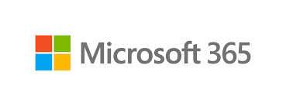
Getting to the up to 60% savings
$24 per user
$63 per user
Microsoft 365 E5 Compliance add-on to Microsoft 365 E3
($12)
Compliance Management
Search and eDiscovery; Auditing (Advanced)
Insider Risk Management; Access Control
Information Protection and Governance
$39 more per user
Compliance
($33)
Microsoft 365 E5 Security add-on to Microsoft 365 E3
($12)
Full suite
Identity and Access Management
Intrusion detection, investigation, prevention,
and threat intelligence
Email protection
Endpoint Protection and Response
Cloud Access Security Broker
($30)
Security
60%
Up to
savings
Examples of multi-vendor standalones
Web Direct/Base Price shown for Microsoft offerings. Multi-vendor prices based on publicly available estimated pricing for other vendor solutions and are illustrative.
Notes:
Key slide takeaway: Microsoft Security consolidation can drive licensing savings.
Main points to cover:
Consolidating up to 50 product categories with Microsoft 365 E5 Security and E5 Compliance delivers cost-savings opportunities from a licensing perspective.
Let’s take a slice of the typical multi-vendor security licensing landscape.
On the left we have the typical costs, per user, for:
various security products like email protection, or identity and access management, and for
various compliance products like compliance management, auditing, information protection and governance, and insider risk management.
When you add up these different costs, it runs around $30 per user for security products, and $33 per user for compliance products.
These average dollar costs are based upon published prices across the disparate security solutions based on typical use.
With Microsoft Security, you are able to not only consolidate these capabilities, you get the cost efficiency of working with one provider.
Here we take an example of an organization that already has a Microsoft 365 E3 licensing agreement in place.
For an additional $24 per user, you get all of these security and compliance capabilities, which represent a 60% savings compared to the multi-vendor arrangement.
Citation:
Web Direct/Base Price shown for Microsoft offerings. Multi-vendor prices based on publicly available estimated pricing for other vendor solutions and are illustrative

Slide 8


Additional cost savings through vendor consolidation
Vendor License Cost Consolidation
Microsoft Sentinel, Microsoft 365 Defender, and Microsoft Defender for Cloud | Cost savings of $1.6 million from SIEM and XDR consolidation¹
Microsoft Purview | Cost savings of $2.3 million from retiring legacy third-party software²
Microsoft Endpoint Manager | Retired endpoint management tools decrease costs by over $305,000³
Microsoft Sentinel | 48% less expensive compared to legacy SIEMs. 201% ROI over three years⁴
Microsoft Defender ATP | Reduced costs by sunsetting software and new capability purchase avoidance: $2,347,912⁵
Microsoft Security solutions | Reduced spend from legacy software and infrastructure by over $7 million⁶
“Security for Wiley is security for our customers. With Azure Active Directory, we saved $1 million a year”
Sean Mack
CISO and CIO, Wiley
IT Administration & Deployment Savings
Microsoft Endpoint Manager | Reduced support needs save the organization $1.5 million³
Microsoft Purview | Improved process efficiency valued at $3.1 million²
Azure Active Directory | Reduced IAM team effort led to $1.2 million in annual savings and the ability to reallocate headcount to critical, value-adding areas ⁷
Forrester Consulting showed organizations saved substantially by moving to Microsoft Security
¹Forrester Consulting, “The Total Economic Impact™ Of Microsoft SIEM and XDR”, August 2022, commissioned by Microsoft
²Forrester Consulting, “The Total Economic Impact™ Of Microsoft 365 E5 Compliance,” June, 2021, commissioned by Microsoft
³Forrester Consulting, “The Total Economic Impact™ Of Microsoft Endpoint Manager,” April 2021, commissioned by Microsoft
⁴Forrester Consulting, “The Total Economic Impact™ Of Microsoft Azure Sentinel,” November, 2020, commissioned by Microsoft
⁵Forrester Consulting, “The Total Economic Impact™ Of Microsoft Defender ATP”, April 2019, commissioned by Microsoft
⁶Forrester Consulting, “The Total Economic Impact™ Of Zero Trust Solutions From Microsoft”, December 2021, commissioned by Microsoft
⁷Forrester Consulting, “The Total Economic Impact™ Of Microsoft Azure Active Directory,” August, 2020, commissioned by Microsoft
Notes:
Key slide takeaway: Forrester Consulting “Total Economic Impact” studies show that Microsoft Security helped customers reduce costs through vendor consolidation, reducing IT administration workload, and by moving SIEM solutions to the cloud.
Main points to cover: Microsoft Security can help your organization:
Reduce total cost of on-premises security tools
Achieve cost savings by retiring legacy third-party software and retiring endpoint management tools
Reduce support costs
Improve process efficiency
Reduce cost of licensing, storage, and infrastructure compared to legacy SIEM solution
Citations:
[Cloud security product name references in the Forrester reports may vary due to the name changes as of Nov 02, 2021]
1. Forrester Consulting, “The Total Economic Impact Of Microsoft Azure Security Center,” February, 2021, commissioned by Microsoft
2. Forrester Consulting, “The Total Economic Impact Of Microsoft 365 E5 Compliance,” June, 2021, commissioned by Microsoft
3. Forrester Consulting, “The Total Economic Impact Of Microsoft Endpoint Manager,” April 2021, commissioned by Microsoft
4. Forrester Consulting, “The Total Economic Impact Of Microsoft Azure Sentinel,” November, 2020, commissioned by Microsoft
Quote from customer case study:

Slide 9
.
80%
34%
higher costs when security AI and automation was not fully deployed¹
of all data breaches are caused by insider threats²
85%
$2.3m
reduction in alert queues due to Automation.³
higher costs for breaches with high level of compliance failure¹
¹ Ponemon Institute Cost of Breach Data 2021
² Ponemon Institute Cost of Insider Risk, 2020
³ The Total Economic Impact of Microsoft 365 E5 from Forrester Consulting.
Notes:
Key slide takeaway: Security breaches continue to increase in quantity and complexity. Organizations that consolidate their security portfolio report diminished risk in breaches.
Main points to cover:
80% higher costs when security AI and automation was not fully deployed¹
34% of all data breaches are caused by insider threats²
85% reduction in alert queues due to Automation.³
$2.3M higher costs for breaches with high level of compliance failure¹
Let’s talk about how you can reduce threats with AI and Automation, leading to cost savings for your organization. (click)
Citations:
¹ Ponemon Institute Cost of Breach Data, 2021
² Ponemon Institute Cost of Insider Risk, 2020
³ Forrester Consulting, “The Total Economic Impact Of Microsoft 365 E5 Compliance,” June, 2021, commissioned by Microsoft

Slide 10
Reduce threats with AI and Automation
60%
$10.5
reduced risk of material breach
65%
less time to investigate threats
million additional end user productivity from automation and process improvements in
Microsoft 365 Defender²
88%
less time responding to threats with Microsoft Sentinel, Microsoft 365 Defender, and Microsoft Defender for Cloud¹
96%
90%
Microsoft Security
less time spent monitoring potential suspicious activity with Microsoft Purview³
reduction in noise, elevating the most critical issues with Microsoft Sentinel⁴
¹ Forrester Consulting, “The Total Economic Impact™ Of Microsoft SIEM and XDR”, August 2022, commissioned by Microsoft
² Forrester Consulting, “The Total Economic Impact™ Of Microsoft 365 Defender”, April 2022, commissioned by Microsoft
³ Forrester Consulting, “The Total Economic Impact ™ Of Microsoft 365 E5 Compliance,” February, 2021, commissioned by Microsoft
⁴ Microsoft blog: Azure Sentinel uncovers the real threats hidden in billions of low fidelity signals, Feb 2020
Notes:
Key slide takeaway: We’ve built our products and services to share important threat data with each other, enabling them to automatically correlate data and deliver contextual alerts for more effective threat detection and response.
Main points to cover:
Detect and respond faster and more accurately to attacks and insider risks
Protect and govern your sensitive data
Manage and govern your on-premises, multi-cloud, and software-as-a-service (SaaS) data
Improve compliance, monitor and remediate potentially risky activity, and safely enable productive work for employees using multiple devices in multiple locations.
Here are some savings other organizations have realized, from Forrester Consulting “Total Economic Impact” studies that show how Microsoft Security helped customers reduced the total cost of risk while saving on automation and process improvements:
60% reduced risk of material breach, 65% less time to investigate threats, and 88% less time responding to threats with Microsoft Sentinel, Microsoft 365 Defender, and Microsoft Defender for Cloud 3
96% less time spent monitoring potential suspicious activity with Microsoft Purview ⁴
$10.5 million additional end user productivity from automation and process improvements in Microsoft 365 Defender ⁵
90% reduction in noise, elevating the most critical issues with Microsoft Sentinel ⁶
And more --
A head-to-head evaluation by MITRE, a research firm that tests security tools, found that Microsoft detected the most emergent threats. Those threats, such as credential dumping, process injection, and input capture, would be invisible to conventional tools. MITRE evaluation highlights industry-leading EDR capabilities in Windows Defender ATP, Microsoft Tech Community, Mar 2019
Microsoft Sentinel’s Fusion Technology, a machine learning technique, finds threats that fly under the radar. It combines data from disparate data sets across both Microsoft and partner sources, then uses graph-based machine learning and a probabilistic kill chain to product high-fidelity alerts. This process reduces alert fatigue by 90%, allowing SecOps teams to only spend time on real, actionable alerts. Microsoft blog: Azure Sentinel uncovers the real threats hidden in billions of low fidelity signals, Feb 2020
It is important to end the attack before any damage occurs. In a recent study, Forrester found that our security technology automatically remediates 97 percent of all endpoint attacks detected in customer environments. That automation frees up teams to focus on resolving the most complicated cases. The Total Economic Impact of Microsoft Defender ATP, Forrester, Apr 2019
Insider Risk templates use machine learning and intelligence to correlate signals to identify hidden patterns and risks that traditional or manual methods might miss.
Citations
Microsoft blog: Azure Sentinel uncovers the real threats hidden in billions of low fidelity signals, Feb 2020
The Total Economic Impact of Microsoft Defender ATP, Forrester, Apr 2019
Forrester Consulting, “The Total Economic Impact™ Of ™ Microsoft SIEM and XDR”, August 2022, commissioned by Microsoft
Forrester Consulting, “The Total Economic Impact ™ Of Microsoft 365 E5 Compliance,” February, 2021, commissioned by Microsoft

Slide 11

Additional cost savings through AI and Automation
Reduce Total Cost of Risk
Microsoft Security solutions | Enhanced security reduced the risk of a data breach by 50%¹
Microsoft Purview | Reduced costs from data beaches by 40-50%²
Microsoft Sentinel, Microsoft 365 Defender, and Microsoft Defender for Cloud | Reduced risk of material breach by 60% Reduced time to investigate threats by 65% Reduced time to respond to threats by 88%3
Azure Active Directory | Reducing the complexity of IAM solutions reduced risk of a security breach by 45%⁴
“The automation and orchestration inherent in the Microsoft 365 platform combined with the security of the tools was a differentiator for us.”
Lawrance Zorio
Vice President IT Information, Smith+Nephew
Save On Automation and Process Improvements
Microsoft Sentinel | Reduced false positives 79%⁵ Reduced noise by 90%, elevating the most critical issues⁶
Azure Network Security | Automated upgrades and improved visibility reduced risk of a security breach of 30%⁷
Microsoft 365 Defender | Increased end user productivity from automation and process improvements valued at $10.5 million⁸
Microsoft Cloud App Security | Automated processes eliminated 75% of threats automatically⁹
Microsoft Security solutions | Reduced resources required for audit and compliance management by 25%¹
Forrester Consulting showed organizations saved substantially by moving to Microsoft Security
¹Forrester Consulting, “The Total Economic Impact™ Of Zero Trust Solutions From Microsoft”, December 2021, commissioned by Microsoft
² Forrester Consulting, “The Total Economic Impact Of Microsoft 365 E5 Compliance,” February, 2021, commissioned by Microsoft
³¹Forrester Consulting, “The Total Economic Impact™ Of Microsoft SIEM and XDR”, August 2022, commissioned by Microsoft
⁴ Forrester Consulting, “The Total Economic Impact Of Microsoft Azure Active Directory,” August, 2020, commissioned by Microsoft
⁵ Forrester Consulting, “The Total Economic Impact Of Microsoft Azure Sentinel,” November, 2020, commissioned by Microsoft
⁶ Microsoft blog: Azure Sentinel uncovers the real threats hidden in billions of low fidelity signals, Feb 2020
⁷ Forrester Consulting, “The Total Economic Impact Of Microsoft Azure Network Security” May, 2021, commissioned by Microsoft
⁸ Forrester Consulting, “THE TOTAL ECONOMIC IMPACT™ OF MICROSOFT 365 DEFENDER”, April 2022, commissioned by Microsoft
⁹ Forrester Consulting, “The Total Economic Impact™ Of Microsoft Cloud App Security”, May 2020, commissioned by Microsoft
Notes:
Key slide takeaway: Forrester Consulting “Total Economic Impact” studies show that Microsoft Security helped customers reduced the total cost of risk while saving on automation and process improvements.
Main points to cover: Microsoft Security can help your organization:
Reduce costs by reducing risk of breach
Reduce cloud security breach risk and decrease time to mitigate cloud threats by centrally managing cloud platform security operations
Reducing risk of a security breach by reducing the complexity of IAM solutions
Reduce false positives
Reduce risk of a security breach by automating upgrades and improve visibility
Citations:
[Cloud security product name references in the Forrester reports may vary due to the name changes as of Nov 02, 2021]
1. Forrester Consulting, “The Total Economic Impact Of Microsoft 365 E5 Compliance,” February, 2021, commissioned by Microsoft
2. Forrester Consulting, “The Total Economic Impact Of Microsoft Azure Security Center,” June, 2021, commissioned by Microsoft
3. Forrester Consulting, “The Total Economic Impact Of Microsoft Azure Active Directory,” August, 2020, commissioned by Microsoft
4. Forrester Consulting, “The Total Economic Impact Of Microsoft Azure Sentinel,” November, 2020, commissioned by Microsoft
5. Forrester Consulting, “The Total Economic Impact Of Microsoft Azure Network Security” May, 2021, commissioned by Microsoft
Quote from customer case study:
Microsoft Customer Story-A healthy edge: Medical technology leader Smith+Nephew uses Microsoft 365 to innovate
https://customers.microsoft.com/en-us/story/1393723474425028635-smith-nephew-manufacturing-microsoft-365

Slide 12
.
150%
$1.07m
increase in ransomware attacks in 2021¹
cost difference where remote work was a factor in causing the breach²
579
$1.76m
password attacks are carried out every second¹
higher costs without mature zero trust deployed²
¹ https://www.bloomberg.com/news/videos/2021-12-09/microsoft-fires-back-at-crowdstrike-on-cybersecurity-video
² Ponemon Institute Cost of Breach Data 2021.
Notes:
Key slide takeaway: Integrated workflows help ensure that the right people across security, HR, legal, and compliance are involved to quickly investigate and act once a risk has been identified.
Main points to cover:
Organizations struggle to navigate the ever-evolving threat landscape in which ransomware attacks increased by 150% in 2021, 579 password attacks are carried out every second, and nation-state attacks are also on the rise. (1)
At the same time, the pandemic accelerated digital transformation faster than anyone could’ve expected over the past two years.
Breaches are more expensive when remote work is a factor, and also in organizations who haven’t implemented a strong zero trust foundation. (2)
Organizations are constantly adding new cloud solutions, applications, and experiences to support more dynamic workforce and growing business needs, expanding attack surfaces for adversaries to take advantage of.
Besides significant business disruptions, these attacks also result in devasting economic damages that the cost of cybercrime is expected to grow at 15% year over year, reaching $10.5 trillion by 2025. (3)
Citations:
¹ https://www.bloomberg.com/news/videos/2021-12-09/microsoft-fires-back-at-crowdstrike-on-cybersecurity-video
² Ponemon Institute Cost of Breach Data 2021
https://cybersecurityventures.com/hackerpocalypse-cybercrime-report-2016/

Slide 13
Improve Operational Efficiency
73%
67%
reduced time to deployment with Microsoft Sentinel¹
improved efficiency of network-related IT work with Azure Network Security²
75%
$479k
Microsoft Security
reduction in password requests after introducing
Self-service Single-Sign-On (SSO) with
Azure Active Directory³
in human capital freed up by redeploying IT time with Microsoft Endpoint Manager⁴
¹ Forrester Consulting, “The Total Economic Impact ™ Of Microsoft Azure Sentinel,” November, 2020, commissioned by Microsoft
² Forrester Consulting, “The Total Economic Impact ™ Of Microsoft Azure Network Security” May, 2021, commissioned by Microsoft
³ Forrester Consulting, “The Total Economic Impact™ Of Zero Trust Solutions From Microsoft”, December 2021, commissioned by Microsoft
⁴ Forrester Consulting, “The Total Economic Impact ™ Of Microsoft Endpoint Manager,” April 2021, commissioned by Microsoft
Notes:
Key slide takeaway: Microsoft Security provides significant value leading to a cost-effective, consolidated security environment.
Main points to cover:
Potential cost savings:
Forrester Consulting showed organizations saved substantially by moving to Microsoft Security
73% improved efficiency of network-related IT work with Azure Network Security 7
67% reduced time to deployment with Microsoft Sentinel ⁸
75% reduction in password requests after introducing Self-service Single-Sign-On (SSO) with Azure Active Directory 9
$479,000 in human capital freed up by redeploying IT time with Microsoft Endpoint Manager 10
Citations
7 Forrester Consulting, “The Total Economic Impact ™ Of Microsoft Azure Network Security” May, 2021, commissioned by Microsoft
8. Forrester Consulting, “The Total Economic Impact ™ Of Microsoft Azure Sentinel,” November, 2020, commissioned by Microsoft
9. Forrester Consulting, “The Total Economic Impact™ Of Zero Trust Solutions From Microsoft”, December 2021, commissioned by Microsoft
10. Forrester Consulting, “The Total Economic Impact ™ Of Microsoft Endpoint Manager,” April 2021, commissioned by Microsoft

Slide 14

Additional cost savings through improved operational efficiency
IT Admin and Deployment Savings
Microsoft Endpoint Manager | Reduced support needs saved the organization $1.5 million Redeployed IT time frees up $479,000 in human capital, to be applied to under-resourced projects¹
Microsoft Security solutions | Reduced the effort required to provision and secure new infrastructure by 80%²
Microsoft Sentinel, Microsoft 365 Defender, and Microsoft Defender for Cloud | Reduced time to create a new workbook by 90% Reduced time to onboard new security professionals by 91% Improved productivity of other employees by almost 68,000 hours annually³
Azure Active Directory | Self-service Single-Sign-On (SSO) reduced password reset requests by 75%, saving $2.9 million/year and users 10 minutes per week ⁴
Azure Network Security | Improved efficiency of network-related IT work by 73% Reduced the number of security and IAM-related help desk calls by 50% Accelerated the process to set up end users on new devices by 75%⁵
Microsoft Purview | Decreased the time spent on ongoing monitoring and checking indicators of potential suspicious activity by 96% Improved process efficiency valued at $3.1 million⁶
Microsoft Defender ATP | Reduced SecOps and IT efforts for efficiency gains of $601,792 Recovered business end user productivity valued at $3,135,789⁷
Microsoft 365 Defender | Increased the efficiency of security teams by 50%²
Microsoft Cloud App Security | Reduced time and effort to remediate incidents by 80%⁸
“It’s about making the right security investments, not necessarily investing more. Making sure all of your systems work together so that threats are caught early and remediation can be swift.”
Bret Arsenault
VP and CISO,
Microsoft
Forrester Consulting showed organizations saved substantially by moving to Microsoft Security
¹Forrester Consulting, “The Total Economic Impact™ Of Microsoft Endpoint Manager,” April 2021, commissioned by Microsoft
² Forrester Consulting, “The Total Economic Impact™ Of Zero Trust Solutions From Microsoft”, December 2021, commissioned by Microsoft
³ Forrester Consulting, “The Total Economic Impact™ Of Microsoft SIEM and XDR”, August 2022, commissioned by Microsoft
⁴ Forrester Consulting, “The Total Economic Impact™ Of Microsoft Azure Active Directory,” August, 2020, commissioned by Microsoft
⁵ Forrester Consulting, “The Total Economic Impact™ Of Microsoft Azure Network Security” May, 2021, commissioned by Microsoft
⁶ Forrester Consulting, “The Total Economic Impact™ Of Microsoft 365 E5 Compliance,” February, 2021, commissioned by Microsoft
⁷ Forrester Consulting, “The Total Economic Impact™ Of Microsoft Defender ATP”, April 2019, commissioned by Microsoft
⁸ Forrester Consulting, “The Total Economic Impact™ Of Microsoft Cloud App Security”, May 2020, commissioned by Microsoft
Notes:
Key slide takeaway: Forrester Consulting “Total Economic Impact” studies show that Microsoft Security helped customers achieve efficiencies and reduce time spent maintaining their security.
Main points to cover: Microsoft Security can help your organization:
Redeploy IT time to free up human capital, which can be applied to under-resourced projects
Save time to deployment with pre-built SIEM content and out-of-the box functionality
Reduce time spent on security policy and compliance management
Reduce password reset requests by enabling self-service
Improve efficiency of network-related IT work
Decrease the time spent on ongoing monitoring and checking indicators of potential suspicious activity
Citations:
[Cloud security product name references in the Forrester reports may vary due to the name changes as of Nov 02, 2021]
1. Forrester Consulting, “The Total Economic Impact Of Microsoft Endpoint Manager,” April 2021, commissioned by Microsoft
2. Forrester Consulting, “The Total Economic Impact Of Microsoft Azure Sentinel,” November, 2020, commissioned by Microsoft
3. Forrester Consulting, “The Total Economic Impact Of Microsoft Azure Security Center,” June, 2021, commissioned by Microsoft
4. Forrester Consulting, “The Total Economic Impact Of Microsoft Azure Active Directory,” August, 2020, commissioned by Microsoft
5. Forrester Consulting, “The Total Economic Impact Of Microsoft Azure Network Security” May, 2021, commissioned by Microsoft
6. Forrester Consulting, “The Total Economic Impact Of Microsoft 365 E5 Compliance,” February, 2021, commissioned by Microsoft

Slide 15
Cost Savings Calculations
Notes:
Key slide takeaway: Today we’re going to talk about how Microsoft Security can help your organization do more with less with Microsoft Security.

Slide 16
Annual potential cost savings
Microsoft 365 E5 Security, E5 Compliance and Microsoft Sentinel | 20,000 seats | 10,000 seats | 5,000 seats
Vendor License Cost Consolidation Reduce license cost by | $5,300,000 | $2,600,000 | $1,300,000
IT Administration & Deployment Savings Reduced IT administration and deployments costs | $2,500,000 | $1,300,000 | $630,000
Reduce total cost of risk Faster threat detection & remediation, reduced data loss | $1,200,000 | $786,000 | $585,000
Save on Automation and Process improvements Less time spend on analysis & reporting, reduced application downtime | $6,000,000 | $3,200,000 | $1,800,000
Capex to Opex Cash Flow* Avoided costs of legacy SIEM solution​ | $416,000 | $416,000 | $416,000
Potential cost savings per year | Up to $15.4M | Up to $8.3M | Up to $4.7M
*Moving from upfront Capital Expenditures to Operational Expenditure for easier Cash Flow
Rounded estimates based on commissioned Forrester TEI studies and Microsoft Value calculator and illustrate first year costs for 20,000, 10,000 and 5,000 employee organizations with Microsoft Sentinel 500 GB daily log absorption. Contact your Microsoft representative for estimates for your organization.
Notes:
Key slide takeaway: Organizations of every size can achieve sizable cost savings across five categories – vendor license consolidation, IT administration and deployment savings, reducing the total cost of risk, saving on automation and process improvements, and moving SIEM expenses from Capex to Opex.
Main points to cover:
Savings shown are rounded estimates based on commissioned Forrester TEI studies and the Microsoft Value calculator, and illustrate first year costs for 20,000, 10,000 and 5,000 employee organizations licensing Microsoft 365 E5 Security and Microsoft 365 E5 Compliance, with Microsoft Sentinel 500 GB daily log absorption.
Our cost savings are different for every customer based upon their size, deployment schedule, cloud adoption maturity, & software landscape, etc.
We have the tools, to help you to understand exactly what these costs are, across these cost savings buckets, based upon your specific company criteria.
Citations: *Moving from upfront Capital Expenditures to Operational Expenditure for easier Cash Flow

Slide 17
Estimated cost savings from consolidation ​
Microsoft 365 E5 Security, E5 Compliance and Microsoft Sentinel | 20,000 seats | 10,000 seats | 5,000 seats
Vendor License Cost Consolidation Reduce license cost by | $5,300,000 | $2,600,000 | $1,300,000
IT Administration & Deployment Savings Reduced IT administration and deployments costs ​ Administration costs reduced with Microsoft Compliance​ | $2,109,000​ $409,000​ | $1,054,000 $205,000 | $527,000 $102,000
Capex to Opex Cash Flow* Avoided costs of legacy SIEM solution​ | $416,000 | $416,000 | $416,000
Potential cost savings per year | Up to $8.2M | Up to $4.2M | Up to $2.3M
*Moving from upfront Capital Expenditures to Operational Expenditure for easier Cash Flow
Rounded estimates based on commissioned Forrester TEI studies and Microsoft Value calculator and illustrate annual costs for a 20,000, 10,000 and 5,000 employee organizations with Azure Sentinel 500 GB daily log absorption. Contact your Microsoft representative for estimates for your organization.
Notes:
Key slide takeaway: Organizations of every size can achieve sizable cost savings through vendor consolidation, reducing IT administration and deployment expenditures, and moving SIEM expenses from Capex to Opex.
Main points to cover:
Savings shown are rounded estimates based on commissioned Forrester TEI studies and the Microsoft Value calculator, and illustrate annual costs for 20,000, 10,000 and 5,000 employee organizations licensing Microsoft 365 E5 Security and Microsoft 365 E5 Compliance, with Microsoft Sentinel 500 GB daily log absorption.
Cost savings are different for every customer based upon their size, deployment schedule, cloud adoption maturity, & software landscape, etc.
We have the tools to help you to understand exactly what these costs are, across these cost savings buckets, based upon your specific company criteria.
Microsoft Value Calculator
Citations:
*Moving from upfront Capital Expenditures to Operational Expenditure for easier Cash Flow
Rounded estimates based on commissioned Forrester TEI studies and Microsoft Value calculator and illustrate annual costs for a 20,000, 10,000 and 5,000 employee organizations with Azure Sentinel 500 GB daily log absorption. Contact your Microsoft representative for estimates for your organization.

Slide 18
Estimated cost savings from reducing risk through AI & automation
Microsoft 365 E5 Security, E5 Compliance and Microsoft Sentinel | 20,000 seats | 10,000 seats | 5,000 seats
Reduce Total Cost of Risk Faster remediation of endpoint security events Reduced data loss from security breaches and mitigation Threat detection and response SecOps efficiency gains | $495,000 $372,000 $318,000 | $253,000 $372,000 $159,000 | $132,000 $372,000 $79,000
Save on Automation & Process Improvements Reduced eDiscovery analysis effort Reduced time spent on compliance audits and processes Automate investigations with Microsoft Sentinel Reduced downtime through improved application performance Improved cloud app security audit reporting | $1,309,000 $2,822,000 $289,000 $1,151,000 $24,000​ | $654,000 $1,411,000 $289,000 $575,000 $24,000 | $327,000 $705,000 $289,000 $287,000 $24,000
Potential cost savings per year | Up to $6.7M | Up to $3.7M | Up to $2.2M
Rounded estimates based on commissioned Forrester TEI studies and Microsoft Value calculator and illustrate annual costs for a 20,000, 10,000 and 5,000 employee organizations with Microsoft Sentinel 500 GB daily log absorption. Contact your Microsoft representative for estimates for your organization.
Notes:
Key slide takeaway: Organizations of every size can achieve sizable cost savings, including reducing the cost of risk and saving on automation and process improvements.
Main points to cover:
Savings shown are rounded estimates based on commissioned Forrester TEI studies and the Microsoft Value calculator, and illustrate annual costs for 20,000, 10,000 and 5,000 employee organizations licensing Microsoft 365 E5 Security and Microsoft 365 E5 Compliance, with Microsoft Sentinel 500 GB daily log absorption.
Cost savings are different for every customer based upon their size, deployment schedule, cloud adoption maturity, & software landscape, etc.
We have the tools to help you to understand exactly what these costs are, across these cost savings buckets, based upon your specific company criteria.
Microsoft Value Calculator
Citations:
Rounded estimates based on commissioned Forrester TEI studies and Microsoft Value calculator and illustrate annual costs for a 20,000, 10,000 and 5,000 employee organizations with Azure Sentinel 500 GB daily log absorption. Contact your Microsoft representative for estimates for your organization.

Slide 19
Estimated cost savings from Improved Operational Efficiency
Microsoft 365 E5 Security, E5 Compliance and Microsoft Sentinel | 20,000 seats | 10,000 seats | 5,000 seats
IT Administration & Deployment Savings Reduced IT administration and deployments costs ​ Administration costs reduced with Microsoft Compliance​ | $2,109,000​ $409,000​ | $1,054,000 $205,000 | $527,000 $102,000
Save on Automation & Process Improvements Reduced eDiscovery analysis effort Reduced time spent on compliance audits and processes Automate investigations with Microsoft Sentinel Reduced downtime through improved application performance Improved cloud app security audit reporting | $1,309,000 $2,822,000 $289,000 $1,151,000 $24,000​ | $654,000 $1,411,000 $289,000 $575,000 $24,000 | $327,000 $705,000 $289,000 $287,000 $24,000
Potential cost savings per year | Up to $5.5M | Up to $4.2M | Up to $2.2M
Rounded estimates based on commissioned Forrester TEI studies and Microsoft Value calculator and illustrate annual costs for a 20,000, 10,000 and 5,000 employee organizations with Microsoft Sentinel 500 GB daily log absorption. Contact your Microsoft representative for estimates for your organization.
Notes:
Key slide takeaway: Organizations of every size can achieve sizable cost savings, including reducing IT and administration efforts and saving on automation and process improvements.
Main points to cover:
Savings shown are rounded estimates based on commissioned Forrester TEI studies and the Microsoft Value calculator, and illustrate annual costs for 20,000, 10,000 and 5,000 employee organizations licensing Microsoft 365 E5 Security and Microsoft 365 E5 Compliance, with Microsoft Sentinel 500 GB daily log absorption.
Cost savings are different for every customer based upon their size, deployment schedule, cloud adoption maturity, & software landscape, etc.
We have the tools to help you to understand exactly what these costs are, across these cost savings buckets, based upon your specific company criteria.
Microsoft Value Calculator
Citations:
Rounded estimates based on commissioned Forrester TEI studies and Microsoft Value calculator and illustrate annual costs for a 20,000, 10,000 and 5,000 employee organizations with Azure Sentinel 500 GB daily log absorption. Contact your Microsoft representative for estimates for your organization.

Slide 20
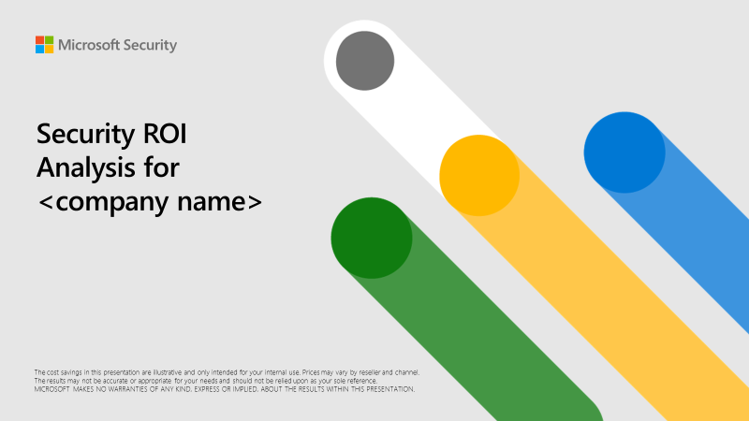
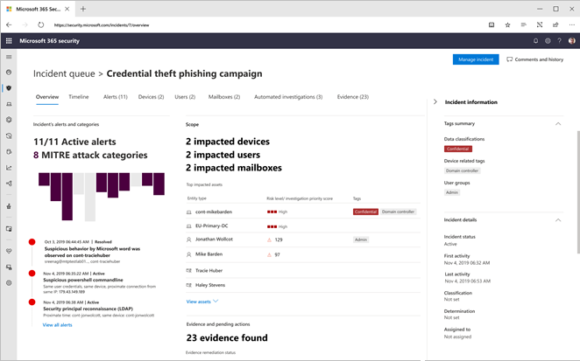
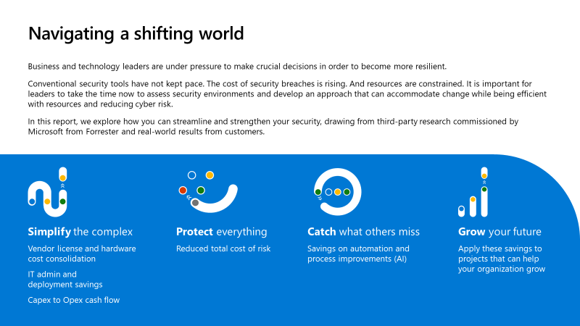
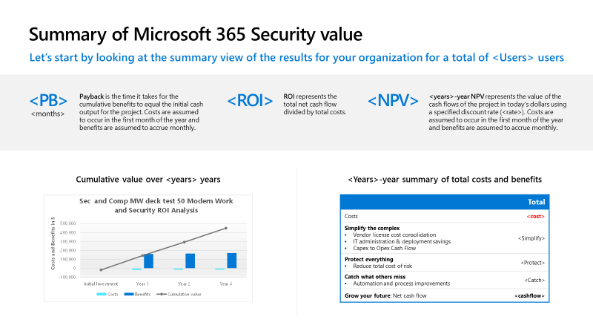
Next steps
Let us help you get started.
Request a Security Workshop to learn how Microsoft can help improve your security posture.
Get a customized Security ROI Report for your organization.
Notes:
Key slide takeaway: Next steps
Main points to cover:
We have a couple of great ways to learn more how Microsoft Security can provide this type of savings, while strengthening your security posture.
First, we have a great Security Workshop where we spend some time assessing your current security posture, and then provide ways that you can improve through Microsoft Security.
Secondly, you can get a customized Security ROI report from the Microsoft Value Calculator, showing how your organization can benefit from Microsoft Security.
Security Workshops - https://m365partneraccelerator.azurewebsites.net
Value Calculator:
Internal link: https://vc.transform.microsoft.com
External link: https://roi.transform.microsoft.com

Slide 21
.

Slide 22

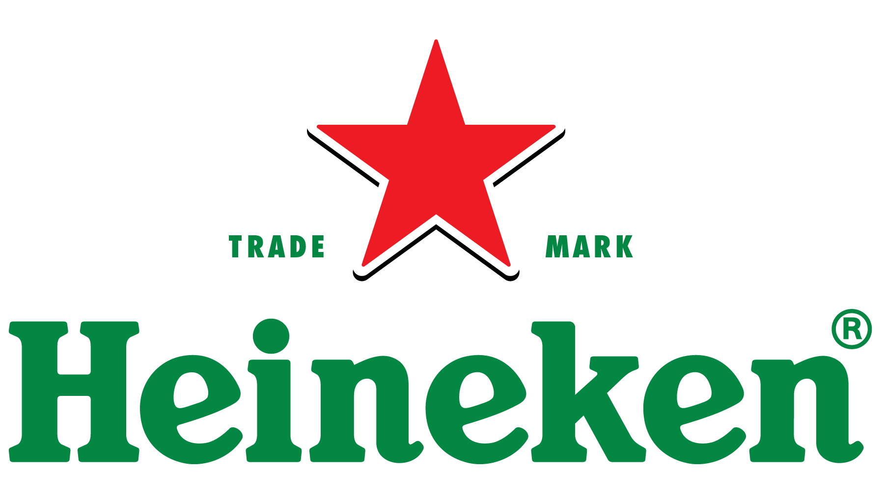
.
Products and services
Microsoft Azure Active Directory
Microsoft Defender for Cloud Apps
Microsoft Defender for Identity
Microsoft Defender for Endpoint
Microsoft 365 E5
Microsoft Sentinel
Organization size
Corporate (10,000+ employees)
Industry
Consumer Goods
Country
Netherlands
“Microsoft has proven its commitment to security through its intense investments in that area, and Microsoft Security solutions were a gift for our cybersecurity team as we created a new approach to agile security.”
Gabriela Popescu, Cyber Defense and Operations and Technology Manager - Heineken
Heineken believes that the best way to achieve agility in its rapidly changing industry is to manage its own security. Yet it faces all the challenges of a global enterprise, a small security team, and a constantly evolving threat landscape.
The company adopted a hybrid model, outsourcing daily security support and retaining overall management and strategy. It uses Microsoft Security solutions to protect identities and information, and to guard against external threats.
Heineken is achieving the agile, creative IT environment it needs to support its sustainability goals and respond to a changing world, thanks to the productivity and ease of use it has with end-to-end Microsoft Security solutions.
Read the case study

Slide 23


. .
Products and services
Azure Active Directory
Organization size
1,000–9,000 employees
Industry
Media & Entertainment
Country
United States
“Security for Wiley is security for our customers. With Azure Active Directory, we saved $1 million a year, and identity isn’t something our users are thinking about every day because we’ve thought about it.”
Sean Mack, CISO and CIO, Wiley
Wiley, a global, tech-enabled research and education organization based in Hoboken, New Jersey, struggled with an error-prone and complex single sign-on (SSO) solution. The company wanted time for innovation rather than simply solution maintenance.
Azure Active Directory (AD) was a natural choice for identity and access management, since it’s included in Wiley’s Microsoft 365 subscription. Wiley deployed Azure AD in just six months, enabling users to more securely access business and technical applications.
There’s been widespread user adoption. Wiley saved $1 million in licensing costs by switching from the outdated SSO to Azure AD. Other benefits include advanced security, flexibility, ease of use, and high compatibility with Wiley’s 80 applications.
Read the case study

Slide 24

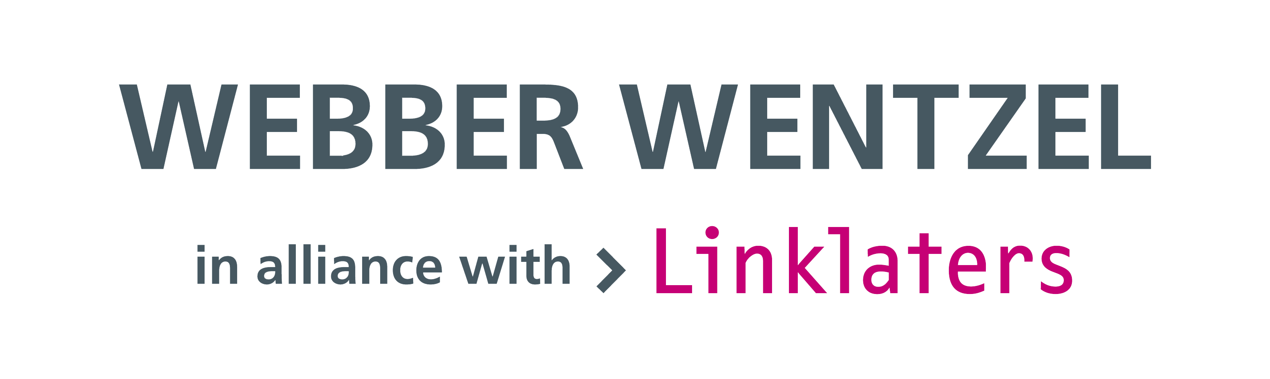
..
Customer: Webber Wentzel
Industry: Professional Services
Size: 50–999 employees
Country: South Africa
Products and services:
Microsoft 365 E5
Microsoft Purview Compliance Manager
Microsoft Purview Data Loss Prevention
Microsoft Purview Records Manager
Microsoft Teams
Microsoft Secure Score
Microsoft Dynamics 365 Read full story here
“When we implemented Microsoft 365 E5 and Microsoft Purview Compliance Manager, I was blown away. The data telemetry and visibility gave us better control of our environment—that’s what helps us sleep.”
—Bethuel Lebepe, IT Security Analyst, Webber Wentzel
Award-winning law firm Webber Wentzel needed an information security management solution to demonstrate its commitment to being a trusted legal advisor, enhance its security and compliance capabilities, protect client privilege, and proactively identify operational risks.
The firm deployed Microsoft Purview Compliance Manager, Microsoft Purview Data Loss Prevention, and the Microsoft 365 E5 security suite to build a modern platform solution, and it deployed Microsoft Secure Score to monitor and measure compliance.
Webber Wentzel reduced security and management costs by around 10 percent and improved its security posture. With centralized data and understandable data visualizations, it better communicates innovation values to other business groups and creates a more meaningful work environment.

Slide 25


….
Customer: DGS Law
Industry: Professional Services
Size: 50 - 999 employees
Country: United States
Products and services: Microsoft Defender Experts for XDR
Read full story here
“I always think of Microsoft as an SMB hero that saves the day with an effective, easily justified solution.”
—Chad Ergun, Chief Information Officer, DGS Law
DGS Law offers the same excellent legal services provided by larger firms, but its smaller size precludes a full-blown team of security experts. How could DGS Law match the IT security offered by larger firms without a huge price tag it would get from an MSSP or large security staff?
DGS capitalized on its existing Microsoft 365 investment, adding the latest managed service: Microsoft Defender Experts for XDR.
The resulting productivity boost for its security teams and Microsoft guidance on the latest threats and alerts puts the firm on an equal footing with goliath firms. With its vendor count down from 36 to 10, DGS Law is agile and ready for the future.

Slide 26
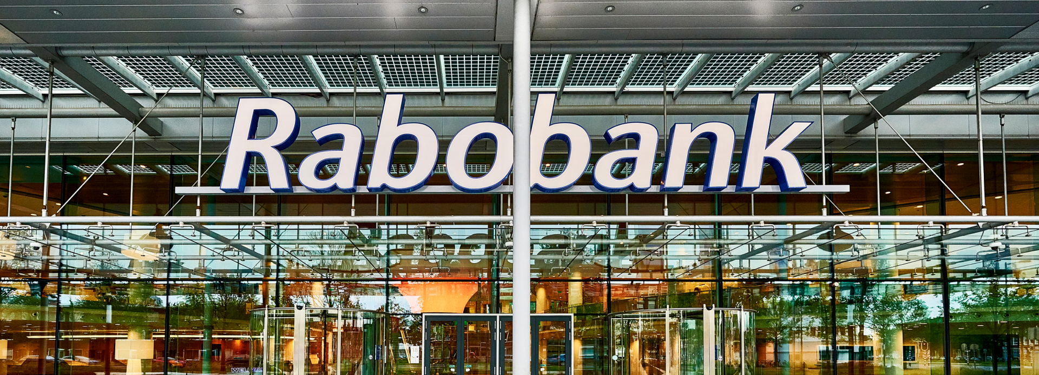
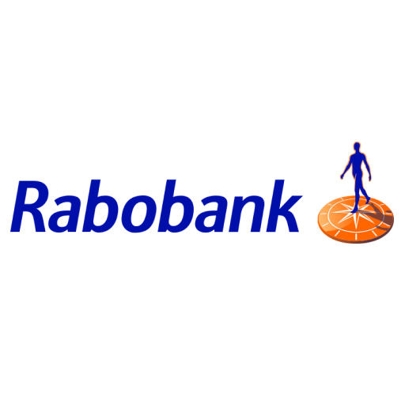
…..
Customer: Rabobank
Industry: Banking & Capital Markets
Size: 10,000+
Country: Netherlands
Products and services: Azure Arc
Azure Monitor
Microsoft 365 E5 Security
Microsoft Azure Active Directory
Microsoft Defender for Cloud
Microsoft Defender for Cloud Apps
Microsoft Defender for Endpoint
Microsoft Defender for Identity
Microsoft Sentinel
Read full story here
"The difference we’ve experienced in visibility and threat detection since deploying Microsoft Security solutions is like night and day.”
—Raoul van der Voort, Global Service Owner, Cyber Defense Center, Rabobank
How does a venerable yet growing global entity balance cutting-edge security, agility, and costs against the demands of a multicloud, hybrid infrastructure that also contains several heterogenous systems? For Rabobank, the answer was clear.
The company rolled out Microsoft Defender for Cloud to monitor hybrid, multicloud workloads and connected it with Microsoft Sentinel and Microsoft Defender for Endpoint for broad visibility.
Rabobank has done away with several high-ticket license fees for non-Microsoft solutions amounting to €400,000 (USD460,000) in cost savings, reducing its vendor count from 20 down to four. But the heightened security it gained is priceless.

Slide 27
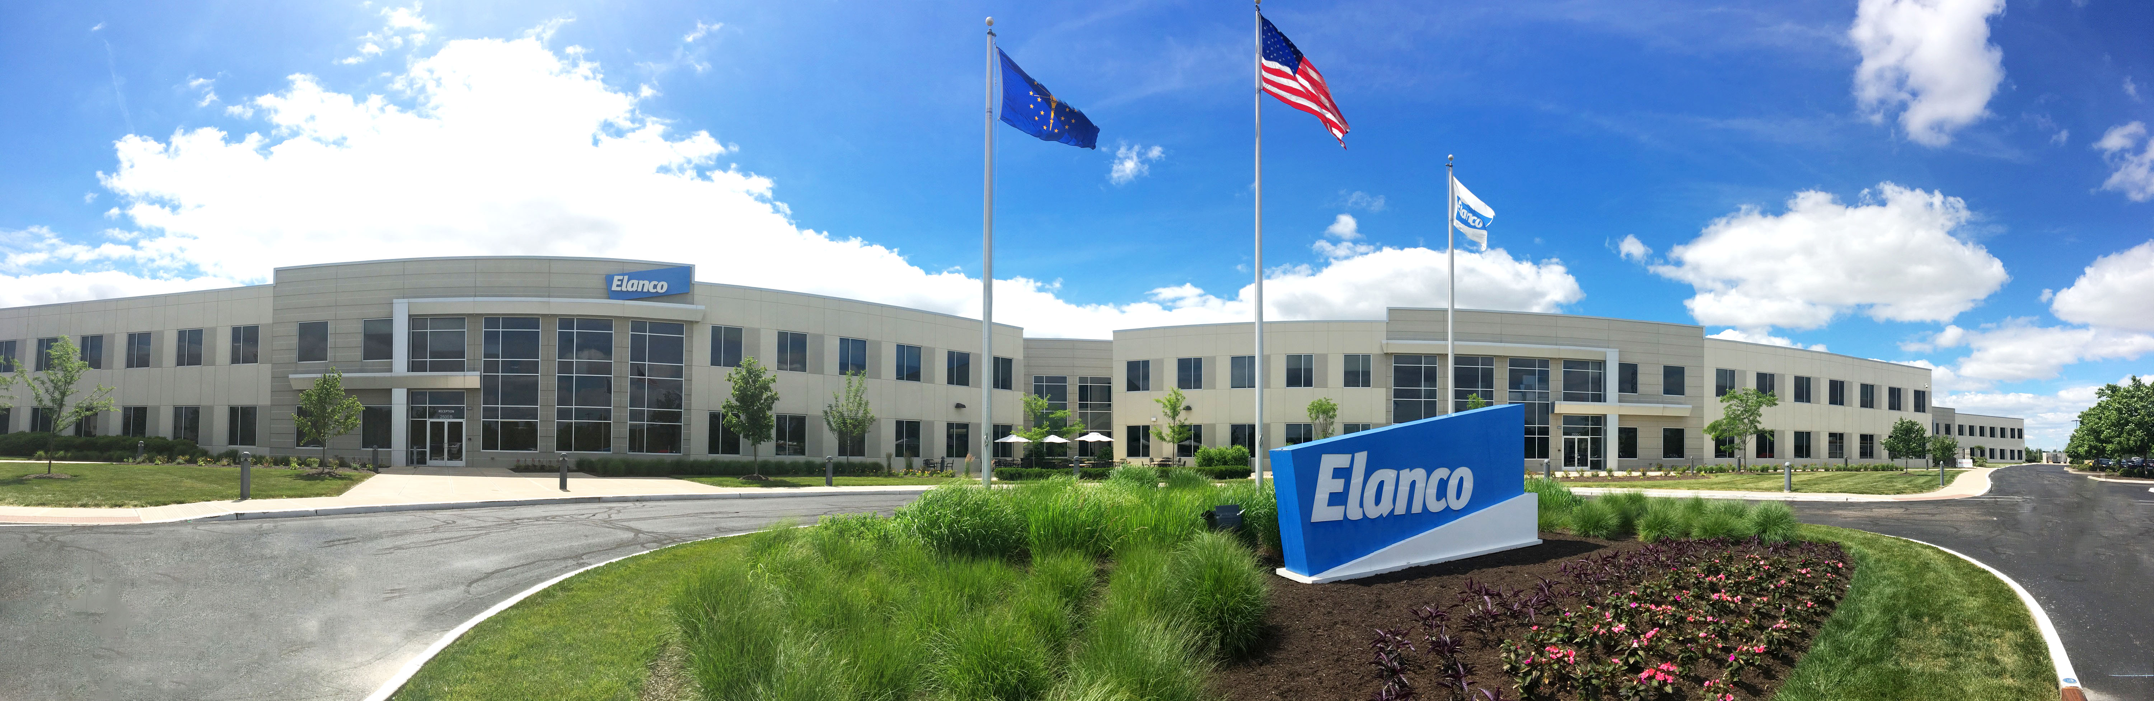
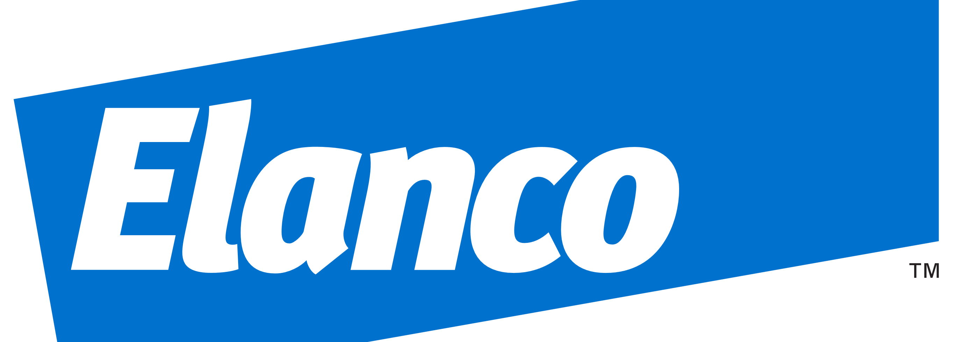
-
Customer: Elanco Industry: Consumer Goods Size: 9,000 employees Country: United States
Products and services: Microsoft 365 E5 Read full story here
“Like us, Microsoft values innovation and collaboration, and that’s reflected in the connected security tool stack it created. That interoperability made it much easier to deploy Microsoft Security solutions.”
—Murtaza Nisar, Chief Information Security Officer, Elanco
Global animal health company Elanco had an enviable greenfield opportunity to build the template for a thoroughly modern IT landscape. At the top of its cybersecurity priority list: be a department of “yes” to its innovative employees while helping keep data safe.
In one condensed 18-month period, the company deployed an extensive selection of Microsoft Security solutions to fit with its Zero Trust strategy, including Azure Active Directory, Microsoft Defender for Identity, and the rest of the Microsoft Defender suite.
Elanco now benefits from a completely connected security landscape that is based around identity security at its core. It saves time for security teams so they can focus on the most complex threats. And everyone at Elanco can innovate and collaborate freely in a highly secure environment.

Slide 28

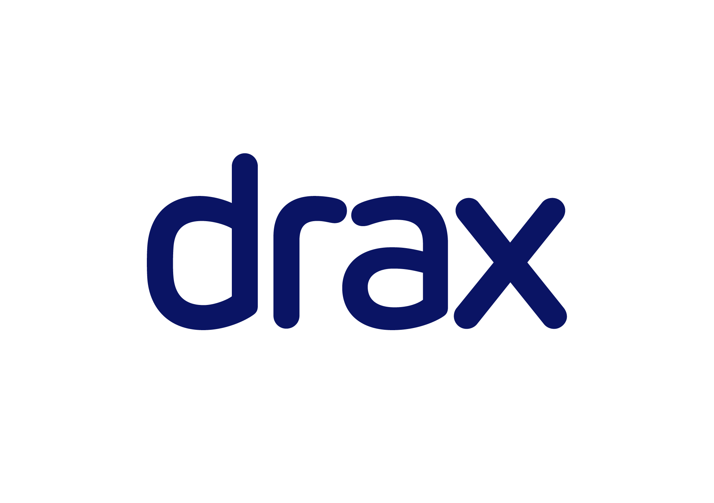
-
Customer: Drax Group
Industry: Energy
Size: 1,000–9,999 employees
Country: United Kingdom
Products and services: Microsoft 365 E5
Microsoft 365 Defender
Microsoft Defender for Endpoint
Microsoft Defender for Identity
Microsoft Whiteboard
Microsoft Power BI
Microsoft Azure
Microsoft Azure Active Directory
Microsoft Azure Defender
Microsoft Azure Security Center
Microsoft Azure Sentinel
Read full story here
“The reason Microsoft provides such a powerful security solution is that it seeks to meet your needs holistically. Each security layer talks to everything else, including those data sources you might be using that are external to Microsoft.”
— Martin Sloan, Security Director, Drax Group
Drax Group, a UK electricity generator that’s part of the nation’s critical infrastructure, wanted to increase its visibility and threat protection capabilities across its IT landscape, unifying its data security approach through a single pane of glass.
Standardizing on Microsoft integrated threat protection, the company is unifying its data intelligence with Azure Sentinel and the extended detection and response capabilities of Microsoft Defender products.
Drax saved 75 percent of its planned integration costs associated with solutions from multiple vendors. And the company created a security solution that protects its data regardless of the types of devices it secures or the location of its employees.

Slide 29
Simplify the complex with solutions that work together, and integrate with third-party products, platforms, and clouds
“Using multiple solutions increases integration complexity between 400 and 500 percent and can also triple the costs of adoption.”
Martin Sloan
Security Director, Drax Group
Notes:
Talk track:
Now let’s take a look at how Drax Group, a major generator of electricity within the United Kingdom, redefined its security strategy. As part of the nation’s critical infrastructure, Drax is a significant target for attackers, and it is incredibly important for them to have effective security tools. Instead of assembling its security solution from multiple vendors’ products and services, Drax adopted a holistic security ecosystem and standardized on Microsoft Security solutions. It was also far simpler and more cost-effective to train their employees to navigate Microsoft Security solutions as they have used Office 365 for years. The standardization has enabled Drax to maintain a high level of security around the company’s data, devices, and employees. Drax uses our integrated SIEM and XDR solution to create a single pane of glass capability of showing them in real time the attacks they were detecting and preventing while also increasing visibility and control. Besides leveraging Microsoft Defender for Identity and Azure Active Directory to strengthen its identity-first security strategy, they also rely on our compliance solutions to stay compliant with Europe’s GDPR legislation.
https://customers.microsoft.com/en-gb/story/1371005622559944055-drax-group-energy-integrated-threat-protection

Slide 30


-
Customer: MVP Health Care
Industry: Health Payor
Size: Large (1,000 – 9,999 employees)
Country: United States
Products and services: Analytics Platform System Azure Azure Active Directory P2 Azure Security Center Azure Sentinel Azure Virtual Desktop Exchange Online Microsoft 365 Defender Microsoft 365 E5 Microsoft Cloud App Security Microsoft Defender for Endpoint Microsoft Defender for Office 365 Microsoft Teams Office 365 Surface Surface Go 2 Surface Hub Surface Laptop
Read full story here
“As we looked at other vendors and platforms, we realized that it was a no-brainer. Microsoft offers the cohesive solution we need. Everything it brings to the table fits beautifully with our direction. It has become an outstanding support for us.”
—Michael Della Villa, Chief Information Officer and Head of Shared Services, MVP Health Care
Regional insurance company MVP Health Care found it can’t rely on its laser-like focus on customer service alone when competing against mega corporations. It needed to maximize internal efficiencies, especially when it came to cybersecurity.
MVP replaced a monolithic, time-intensive solution with Azure Sentinel. It added Azure Security Center, and as part of its Microsoft 365 E5 license, Microsoft Defender for Endpoint, Microsoft Defender for Identity, and more.
The company saves time, money, and precious IT resources—replacing 300 third-party solutions with one connected platform. And with a unified view of the threat landscape, MVP finds it easier to be safer.

Slide 31
Simplify the complex with solutions that work together, and integrate with third-party products, platforms, and clouds
“The entire security suite is seamlessly connected. The effectiveness we get from correlated information to boost security is by far our biggest win.”
James Greene
Cybersecurity consultant, MVP Health Care
Notes:
Note: We have two customer examples to illustrate the second customer promise ‘simplify the complex’ and presenter has the freedom to choose the option that is more relevant to the customers
Talk track:
Now let’s take a look at how US regional health care provider MVP Health Care increased security effectiveness and employee productivity. To protect the sensitive health information of its members and be compliant with regulations, over the years, MVP Health Care has employed over 300 different vendor solutions. Many of these were designed for specialized functions, working in silos, and they have become difficult to manage and scale. MVP Health Care turned to Microsoft for an end-to-end security solution to replace its 300 third-party solutions for a simpler, more proactive, and easily managed security posture while saving time, money, and resources. As part of its deployment, MVP Health Care also switched to Azure Sentinel from previous vendor Splunk to remove management complexity and provide visibility across their entire environment. Azure Sentinel simplifies and expedites tasks as alerts from various Microsoft security products are chained together in an actionable way, allowing the team to easily look up data or follow up on alert.
https://customers.microsoft.com/en-us/story/1338663105513343966-mvp-health-care-health-payor-integrated-threat-protection

Slide 32


Grow your future with the company that is investing in continuous improvement on a scale that few if any other organizations can match
“Until a few years ago, it could take days before we could establish for sure if [an alert] was a false positive. Nowadays, having Microsoft products… makes the triage much faster, down to ten or fifteen minutes.”
Mikko Hakuli
Chief Security Information Officer, Verohallinto
Notes:
Talk track:
What does it mean to say that security can grow your future? It’s a recognition of the fact that managing risk enables an organization to unlock new opportunities and respond quickly to changing conditions.
The Finnish Tax Administration is a global leader in digital taxation. Because the administration handles a wide selection of different data per customer, failing to adequately protect all the sensitive data could have catastrophic effects on the organization and the customers. Even though on-premises provides higher security measures, it cannot keep up with the evolving business needs. As a result, the administration resorted to Microsoft for a more safe and secure cloud. They leverage Microsoft Security solutions such as Microsoft Defender for Endpoints to quickly detect potential threats and identify false positives, reducing triage time significantly. The time saved is spent on further configuring the Microsoft portfolio and driving the cultural change to put security first, allowing the organization to continuously improve its security posture.
https://customers.microsoft.com/en-us/story/1353094605959672931-verohallinto-government-azure-en-finland

Slide 33



A Leader in Security, Compliance, Identity & Management
A Leader in four Gartner® Magic Quadrant™ reports
A Leader in eight Forrester Wave™ categories
A Leader in six IDC MarketScape reports
IDC MarketScape: Worldwide Modern Endpoint Security for Enterprises 2021 Vendor Assessment, Doc #US48306021. November 2021
IDC MarketScape: Worldwide Modern Endpoint Security for Small and Midsize Businesses 2021 Vendor Assessment, Doc #48304721. November 2021
IDC MarketScape: Worldwide Advanced Authentication for Identity Security 2021 Vendor Assessment, Doc #US46178720, July 2021
Gartner does not endorse any vendor, product or service depicted in its research publications and does not advise technology users to select only those vendors with the highest ratings or other designation. Gartner research publications consist of the opinions of Gartner’s Research & Advisory organization and should not be construed as statements of fact. Gartner disclaims all warranties, expressed or implied, with respect to this research, including any warranties of merchantability or fitness for a particular purpose. The Gartner content described herein (the “Gartner Content”) represent(s) research opinion or viewpoints published, as part of a syndicated subscription service, by Gartner, Inc. ("Gartner"), and are not representations of fact. Gartner Content speaks as of its original publication date (and not as of the date of this [type of filing]), and the opinions expressed in the Gartner Content are subject to change without notice. GARTNER and MAGIC QUADRANT are registered trademark and service mark of Gartner, Inc. and/or its affiliates in the U.S. and internationally and are used herein with permission. All rights reserved
The Forrester Wave™ is copyrighted by Forrester Research, Inc. Forrester and Forrester Wave™ are trademarks of Forrester Research, Inc. The Forrester Wave™ is a graphical representation of Forrester’s call on a market and is plotted using a detailed spreadsheet with exposed scores, weightings, and comments. Forrester does not endorse any vendor, product, or service depicted in the Forrester Wave™. Information is based on best available resources. Opinions reflect judgment at the time and are subject to change.
IDC MarketScape: Worldwide Unified Endpoint Management Software 2021 Vendor Assessment
IDC MarketScape: Worldwide Unified Endpoint Management Software for Small and Medium-Sized Businesses 2021 Vendor Assessment
IDC MarketScape: Worldwide Unified Endpoint Management Software for Ruggedized/Internet of Things Deployment 2021 Vendor Assessment

Slide 34
Industry-leading security from Microsoft
43T¹
Analyzing
Threat signals daily
50% increase
32B¹ Blocking
email threats annually
$20B1
Monitoring
140+3
in the next 5 years
Investing to improve and share knowledge, gain insights, and combat cybercrime
Threat groups
40+3
60%
15K1
785K²
Nation state-groups
Keeping you secure, while saving you time and resources
customers rely on Microsoft for their multicloud, multiplatform infrastructure security
Serving billions of global customers, learning and predicting what’s next
Up to savings, on average, over multi-vendor security solutions
partners in security ecosystem
Trusted globally, protecting organizations’ multi-Cloud and multi-platform infrastructures
Earnings Press Release, FY22 Q4. July 26, 2022, Microsoft Investor Relations
“Microsoft Digital Defense Report”. October 2021, Microsoft Security
Earnings Press Release, FY22 Q2. December 16, 2021, Microsoft Investor Relations
Notes:
Talk Track:
•“Microsoft serves billions of customers globally, allowing us to aggregate security data from a broad and diverse spectrum of companies, organizations, and consumers. Informed by over 24 trillion security signals per day, our unique position helps us generate a high-fidelity picture of the current state of cybersecurity, including indicators that help us predict what attackers will do next.” --Digital Defense Report Microsoft Oct 2021
•“Microsoft has made significant and ongoing investments to increase and improve the knowledge we derive from our threat signals. These investments deliver the highly synthesized and integrated insights that we share here. Our goal in aggregating these learnings is to help organizations understand the ways in which cybercriminals are continually shifting their modes of attack—and determine the best ways to combat those attacks.” --Digital Defense Report Microsoft Oct 2021
Source of Facts Below:
•Our primary competitive advantage is that we deliver end-to-end solutions spanning security, compliance, identity, device management, and privacy, across clouds and platforms. These solutions are also consistently recognized as a market leader by Gartner, Forrester and IDC.
•43 trillion threat signals each day combined with the intelligence we track by monitoring more than 40 nation-state groups and over 140 threat groups.
•8,500 security defenders dedicated to thwarting advanced cyberattacks. we continue to disrupt cyberattacks and share threat intelligence with governments, as well as other public sector agencies.
•785,000+ customers trust our security solutions and rely on Microsoft to protect their multi-cloud and multi-platform infrastructure.
•We recognize security is a team sport and have over 15,000 partners in our security ecosystem.
Source:
FY22 Q4 - Press Releases - Investor Relations – Microsoft
Microsoft FY22 Q4 Earnings Report
Microsoft Digital Defense Report – Microsoft Security
FY22 Q2 Earnings Call

Slide 35
Augment your security teams with our world-class research and intelligence teams
Cloud security
Incident response
Nation-state threats
8,500+¹
engineers and researchers always working to mitigate and remediate the next threat
Microsoft and third-party product vulnerabilities
Fraud
Malware
Botnet attacks
IoT security
Microsoft Security research and intelligence
Global intelligence
Cybersecurity policies
300+
members of Microsoft Intelligent Security Association (MISA)
Hardware security
Firmware security
Offensive security
Breach recovery
Phishing
Ransomware
Focused on all areas of the threat landscape.
1. “Defending Against Threats with the Latest Research Insights and Trends”. March 2022, Cyber Signals
2. “Program Overview” 2022, MISA
Notes:
Talk track:
Our security researchers focus on a wide range of topics to not only enhance Microsoft Security offerings but also improve the security of Microsoft ecosystem as a whole.
These world-class research and intelligence teams become an extension to our customers’ security teams.
Discovery Question:
[Insert Customer Name] Are there any of these areas of the threat landscape you have a particular interest in?
Based on your feedback, I’d like to highlight a few of our research and intelligence capabilities to give you a better sense of what we focus on: (can pick a couple, not a must to go through the entire list)
Choose Below:
We are focused on incident response. We have a team called Detection and Response Team (DART) that our large enterprise customers can call on for help when there is an incident. Additionally, this team also actively tracks nation-state threats to understand what techniques they’re using and who they’re targeting next so we can better defend ourselves and our customers.
We have a robust malware research team which dissects malware every day to help our AI get better and improve the detection capablities across our portfolio.
There are researchers focusing on IOT security to ensure the safety of the ever-increasing connected devices.
There is a set of folks focused on cyber policies, supporting security-related executive orders and bringing cyber criminals to justice and unpacking the implications of regulations.
We combine the deep understanding of threat actors and their techniques with our legal expertise and strong partnerships with governments and law enforcement organizations.
We are constantly finding ways to use the legal systems globally to shut down bad actors, for example, those who operate botnets and the dark web.
A big group of the security researchers focus on core firmware security to prevent firmware malware from attaching their code to the firmware’s code and protect a wide range of devices.
For researchers who work on ransomware, their focus is on understanding what the latest techniques are and how we can prevent ransomware from becoming a problem even when there is a breach.
Breach recovery is part of the incident response, but we also have a set of folks focusing on how to build it into our security products so the right actions can be put in place in the event of a breach.
With phishing attacks on the rise, our researchers are focused on dissecting the latest phishing techniques to help improve our anti-phishing capabilities.
Offensive security team is focused on not only doing red team exercises on our own infrastructure and assets but also figuring out how the red team capablities can be leveraged against all Microsoft products so our customers can benefit from the improved product resilience.
We work closely with our hardware partners on not only Windows PCs, but also other types of devices such as IoT to increase hardware security.
Global intelligence encompasses nation-state threats, but it is also about keeping up with the latest trends in the global threat landscape and cyber crimes so we can help educate our customers and make our products better.
We are invested in identifying and eliminating Microsoft and third-party product vulnerabilities. We’ve built relationships with security researchers from different organizations around the world and created an ecosystem that helps facilitates and ensures speedy discovery of vulnerabilities in both our and third-party products and delivery of patches to prevent these vulnerabilities from being exploited.
We have a team focused on understanding the mechanisms of and building protection against fraud to protect our own business. The learnings are also shared with different product teams, so they can be built into the products to help our customers manage fraud in their own environments.
The dedicated cloud security team focuses on how to make our cloud platforms and the services delivered on top secure and how to build the technology into our products so all of our customers can be protected as well.

Slide 36

Microsoft Security ecosystem—the experts other experts rely on
x
Trusted advisor for your security
Digital Defense Report provides updated security guidance annually
Detection and Response Team (DART) responds to security incidents and helps Microsoft customers become cyber-resilient
Streamline your deployment and save on costs
Leverage the FastTrack service included in eligible subscriptions at no additional cost
Large ecosystem of Microsoft certified solution providers
Microsoft Industry Solutions helps organizations adopt tech solutions across digital strategy, data insight, sales, and more
1 month
Find and train the best people quickly
Common tools and interfaces for quick uptake of new capabilities
Rich ecosystem of Learning partners
Microsoft Certifications and skill paths streamline learning
average time reduction to onboard using FastTrack¹
¹ “The Total Economic Impact™ Of Microsoft FastTrack.” Forrester Consulting. October 2017, commissioned by Microsoft
Notes:
Key slide takeaway: Microsoft and our ecosystem are committed to helping our customers protect and defend their data and devices.
Main points to cover:
Microsoft is a trusted security advisor, providing strategic guidance, response teams, and leading through security initiatives and investments (reference slide 27)
Microsoft offers deployment guidance through FastTrack, consultants and partners
Microsoft offers training and certification to help ensure access to highly qualified professionals to deploy and maintain your security solutions
Citations:
“The Total Economic Impact™ Of Microsoft FastTrack.” Forrester. October 2017, commissioned by Microsoft

Slide 37
Protection aligned to where you're going
Solutions to support your digital journey
Protect identity & access for strong Zero Trust foundations
Modernize security & defend against threats
Secure multi-cloud environments
Protect & govern sensitive data
Mitigate compliance & privacy risk
Notes:
Talk track: Our conversations with customers around the world have helped us identify five key security challenges that may be familiar to you. If you are also facing similar or additional challenges, we’d love to chat more by pulling in respective experts and help you achieve your security goals.
Protect identity & endpoints for strong zero trust foundations. Among its six pillars, a Zero Trust Security framework should start with securing the people and the devices that they use to get work done. Both are increasingly important as we navigate a hybrid world where employees will work from anywhere across different business and personal devices. Whether you are thinking about implementing a Zero Trust framework or have already started, we are here to help you secure the hybrid workforce and offer seamless user experiences, so you don’t need to compromise between security and productivity.
Modernize security and defend against threats. As we navigate the hybrid future in additional to facing more sophisticated threats and more complex regulatory environment, security tools also need to evolve. Organizations need to stay ahead of attackers to end attacks before they happen and cause damage, highlighting the need for a unified and efficient SecOps experience and streamlined process leveraging automation and orchestration. If an incident does occur, organizations need to be armed with the tools to quickly verify impact and remediate.
Secure multicloud infrastructure in and outside of Azure. The infrastructure, data, and apps built and run in the cloud are the foundational building blocks for a modern business. No matter where you are in your cloud journey, you likely utilize every layer of the cloud – from IaaS to PaaS to SaaS. More and more organizations today also have a multi-cloud and/or a hybrid strategy to maximize business impact, but at the same time, such strategy complicates security. Organizations today need a security solution that offers multi-cloud protection across every layer for a strong security posture.
Protect and govern sensitive data. Data is the lifeblood of any organization. How business data is handled and processed becomes increasingly important as the amount of data is growing at unprecedented rate and leaving the corporate firewall in the hybrid world. Organizations want to be equipped with the tools to understand their vast data landscape, to know, detect and prevent data loss, leakage, transfer, and theft, while fostering safe and compliant communications.
Mitigate compliance and privacy risk. Manage regulatory compliance requirements while also maintaining their customer & employee privacy. Organizations need to manage regulatory compliance privacy and risk, case management, chain of custody, audit, all while respecting individual rights.

